Slide 1
Demo of the Java RV Prototype
Cheng Ding
23 Aug 2023

Slide 2
Outline
The structure of the prototype tool
How does the tool work
Specifications support
The usage and demo

Slide 3
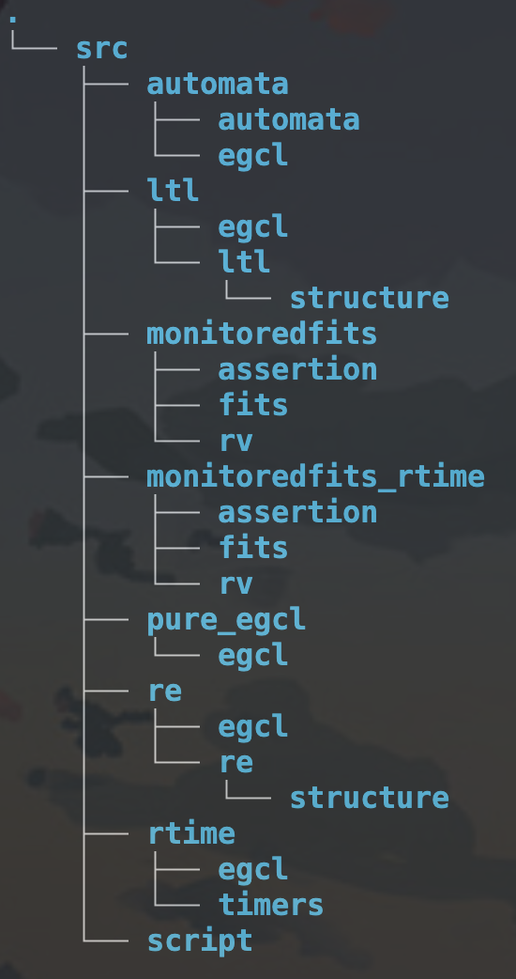
Structure
monitoredfits/monitoredfits_rtime:
There’s the system we verify.
After using the frontend to generate the AspectJ file, we can run the system to check the preperty.

Slide 4
Structure
automata/ltl/re/rtime/pure_egcl:
each folder contains codes that can translate the
corresponding specification files into the AspectJ file(.aj)

Slide 5
Structure
script:
this folder contains specification files
Users need to manually write specifications for the
system so that properties can be checked.

Slide 6
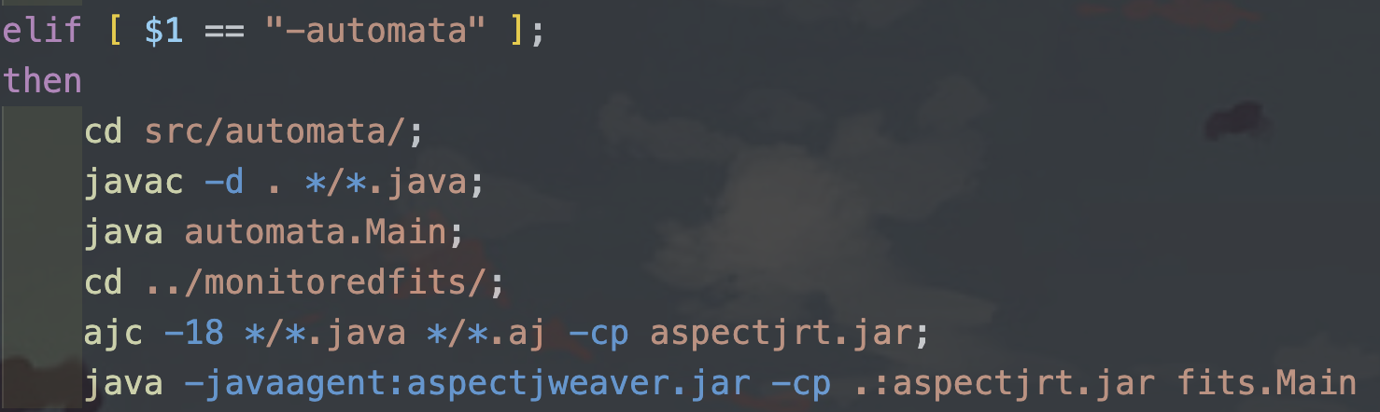
How it works
Take automata as an example
compile and run the frontend translation part
use ajc to compile and weave the aspectj file
run the backend

Slide 7
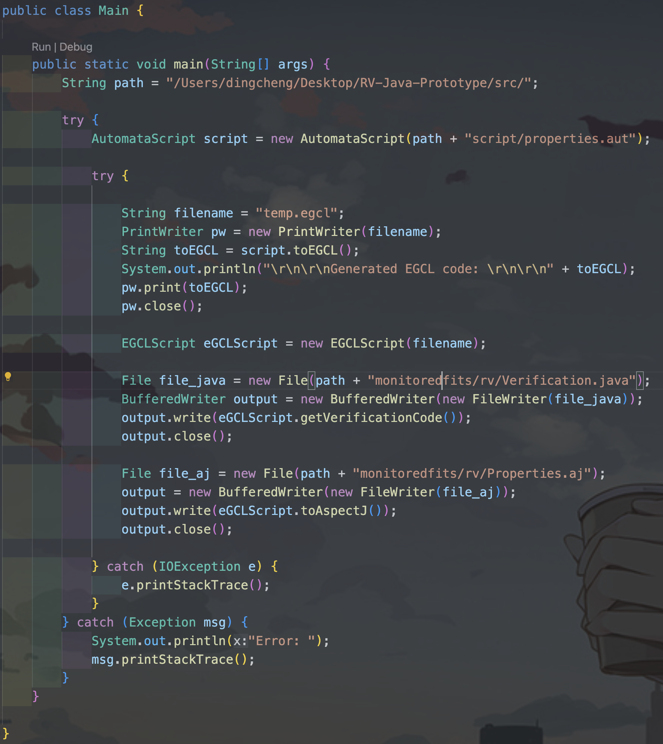
How it works-frontend
automata/Main.java
read from the .aut specification file
parse and translate it into EGCL
then reuse the EGCL translation part to generate
Verification.java and Properties.aj

Slide 8
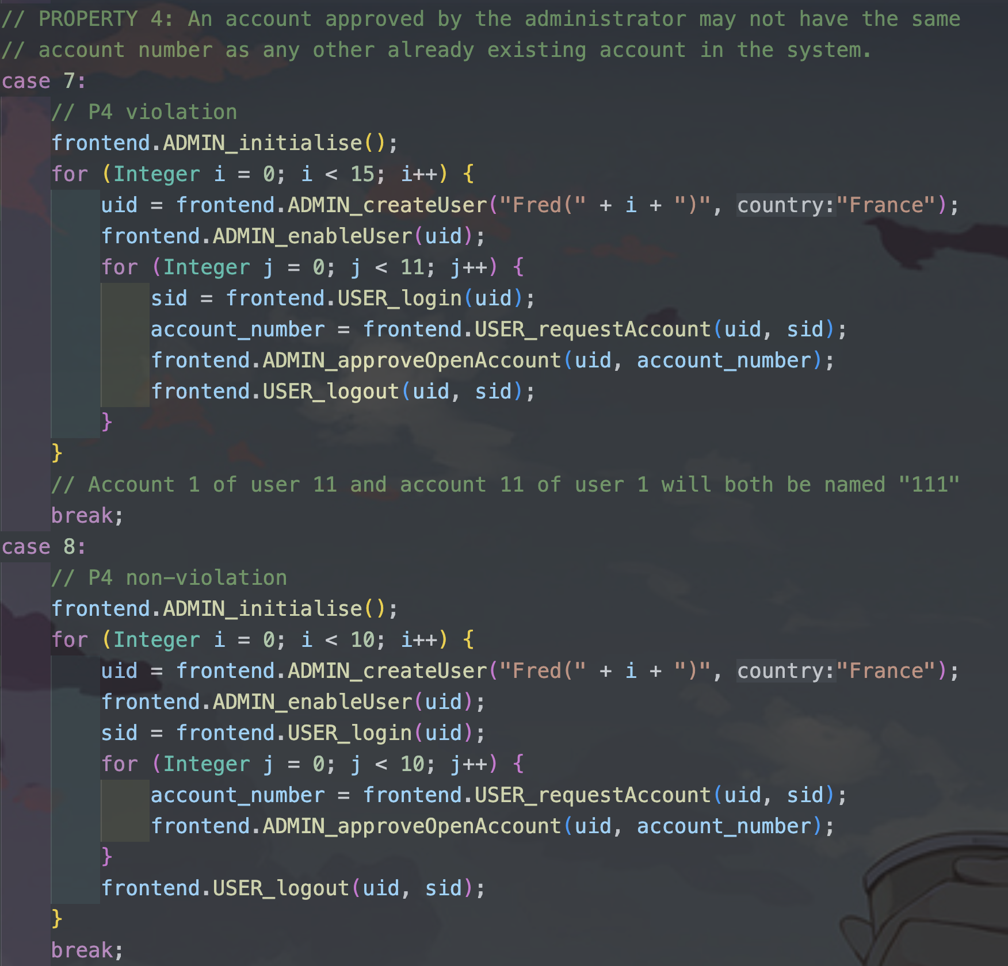
How it works-backend
In this demo:
The backend will run scenarios and check the property
In each scenario, the author manually write some com-
mands that will or will not violate the property
It’s just like a testing case.
In reality:
when the system is running, the monitor will report any
violation defined in the specification files

Slide 9
Specifications
EGCL (Event Guarded Command Language)
E.g.:
before *.makeGoldUser(..) target (UserInfo u)
| !(u.getCountry().equals("Argentina"))
-> { Assertion.alert("P1 violated"); }
before: the point we apply the advice
*.makeGoldUser(..): the event
target (UserInfo u): the object that triggered the event
!(u.getCountry().equals("Argentina")): the condition
Assertion.alert("P1 violated"): the advice we apply

Slide 10
Specifications
Finite Automata
E.g.:
property foreach target (UserInfo u) starting Enabled {
Enabled >>> before UserInfo.makeDisabled(..) target (UserInfo u)
>>> Disabled
Disabled >>> before UserInfo.makeEnabled(..) target (UserInfo u)
>>> Enabled
Disabled >>> before UserInfo.withdrawFrom(..) target (UserInfo u)
>>> Bad [P5 violated]
}

Slide 11
Specifications
RE (regular expressions)
E.g.:
property bad behaviour {
(![before BackEnd.initialise])*;([before BackEnd.initialise];(![before BackEnd.shutdown])*;[before BackEnd.shutdown])*;(![before BackEnd.initialise])*;[before UserInfo.openSession]
}

Slide 12
Specifications
LTL (Linear Temporal Logics)
E.g.:
property good behaviour {
(not [before UserInfo.openSession]) Until [after BackEnd.initialise]
}

Slide 13
Specifications
real-time property
E.g.:
BackEnd.initialise(..) | -> { Verification.initialisedTime = TimerManager.currentTimeMillis(); }
UserInfo.openSession(..) | TimerManager.currentTimeMillis() - Verification.initialisedTime < 10*1000
-> { Assertion.alert("P11 violated"); }

Slide 14
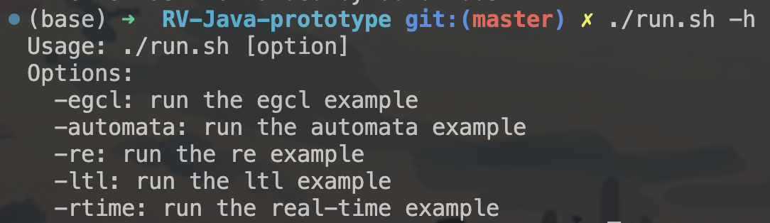
Usage and Demo
manually write specifications for the system in the script/ folder.
use the script run.sh -h to see how to use it.

Slide 15
Thanks for listening!

